Slide 1
CSC621/821 Final Project
Team Earth
Ye Cheng, Dusan Cvetkovic, Ellison Chan, Hin Lok Chan, Bryan Chen, Thomas Mei

Slide 2
Dataset
Head CT image
anonymatized clinical medical image database of National Cancer Institute (NCI) in National Institute of Health (NIH)

Slide 3
registration
Response by
Ye Cheng ,
Hin Lok Chan ( senior oral presentation)

Slide 4
Registration
how demon algorithm work
Why demon
What method to make the registration done
gaussian filter
multiresolution scheme
root-mean-square deviation ( root-mean-square error) // level of tolerance

Slide 5
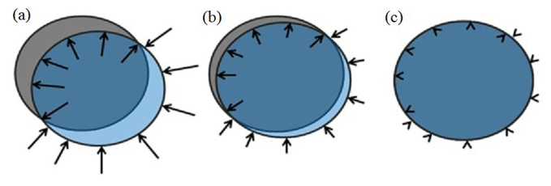
How Demon algorithm works
The algorithm move the movable image to the location that having the same intensity
By http://www.jacmp.org/index.php/jacmp/article/view/3834/2789

Slide 6

intensity
We only have 256 level of intensity since one voxel is only 8 bits.
By http://www.writedesignonline.com/resources/design/rules/color.html

Slide 7
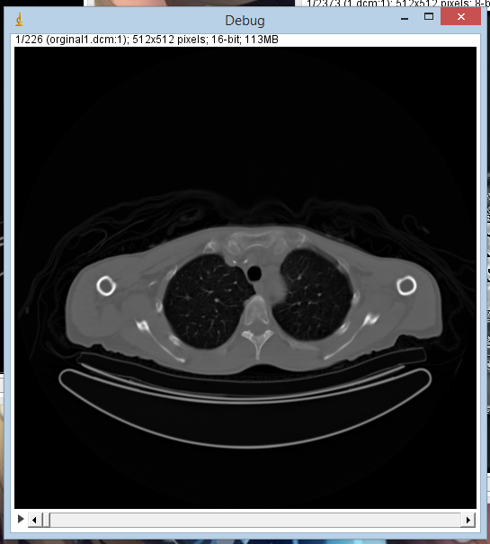
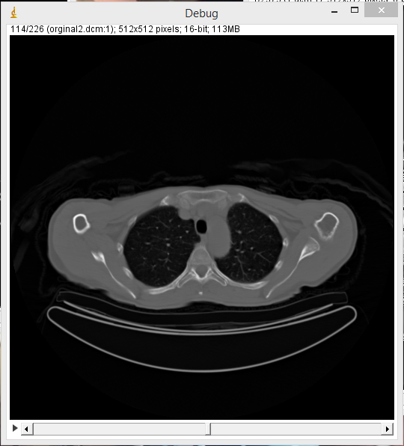
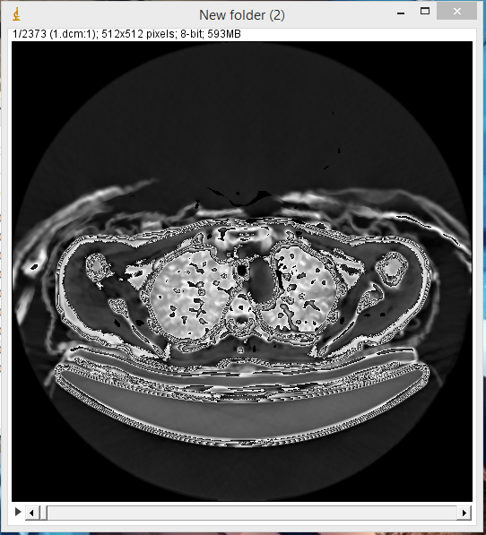
Fixed image
Movable image
Output image

Slide 8
Why demon algorithm
It is a non-rigid, Which image have more freedom to move around

Slide 9
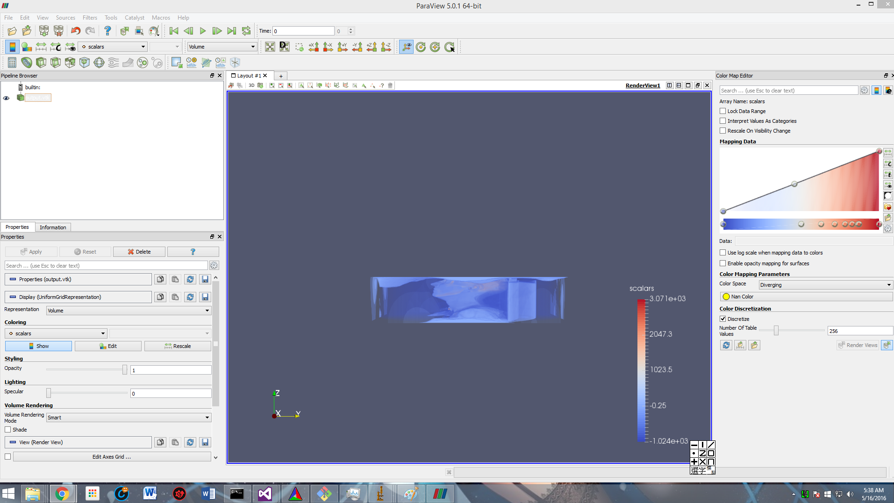

Slide 10
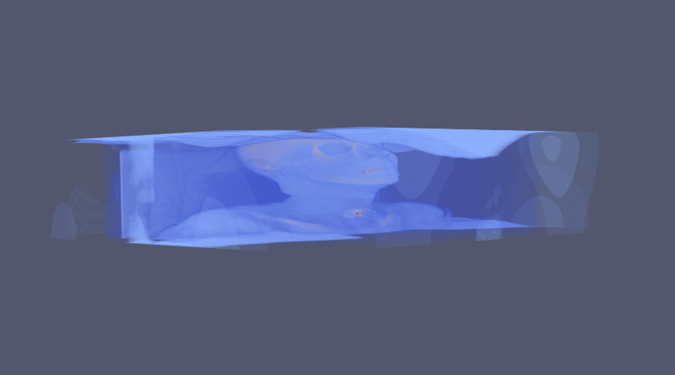

Slide 11
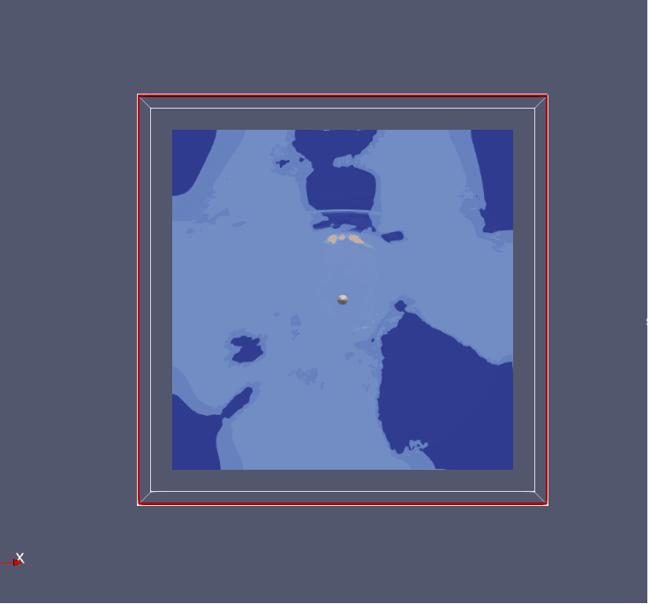
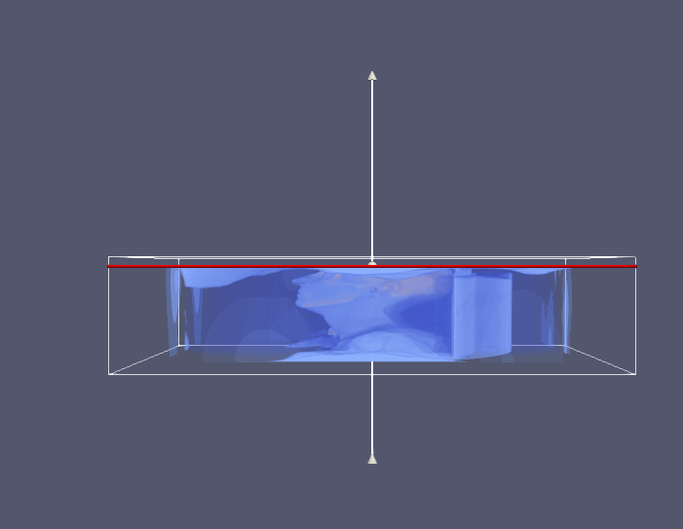

Slide 12
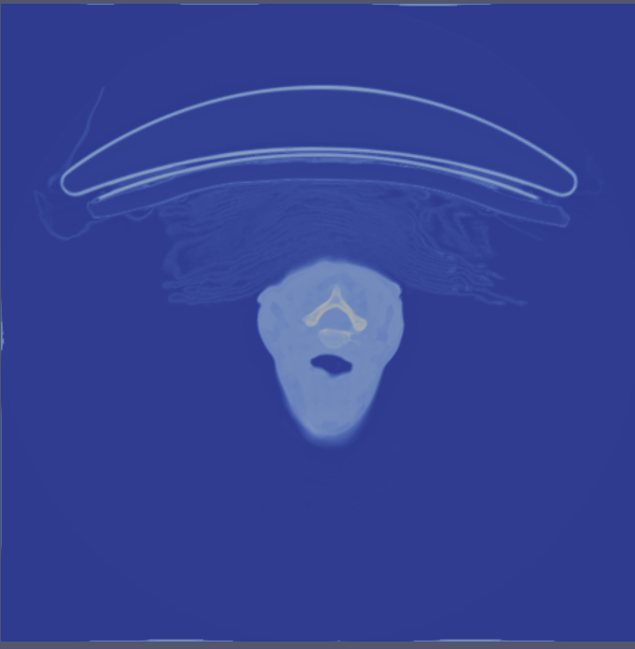
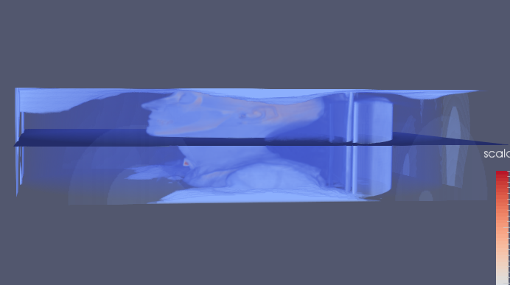

Slide 13
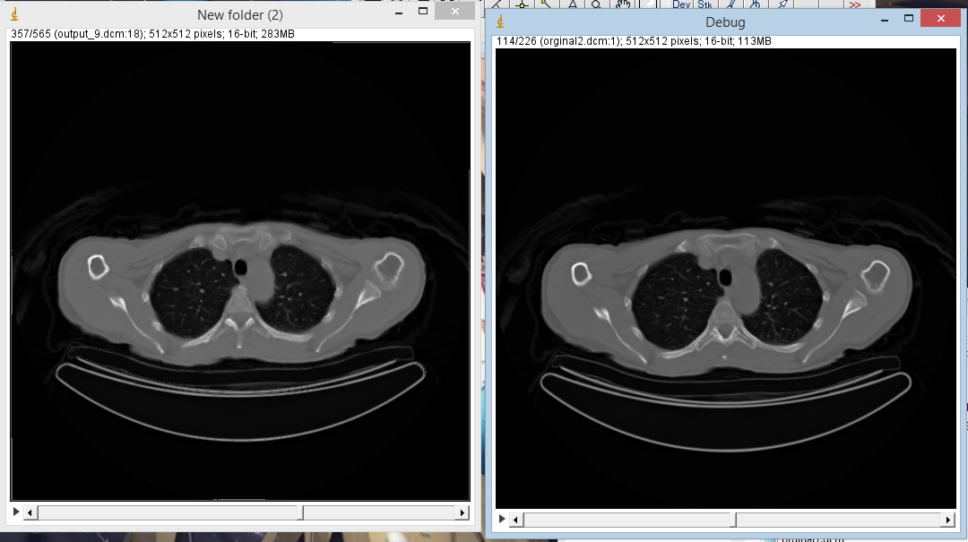

Slide 14
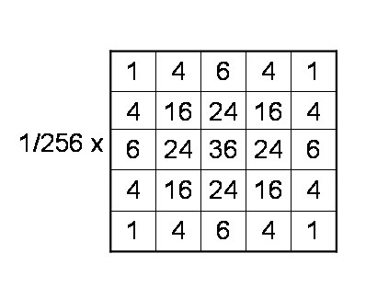
What method to make the registration done
gaussian filter
filter->SetStandardDeviations( 3.0 );
Stand Deviation = sigma

Slide 15
What method to make the registration done
multiresolution scheme
double MaxRmsE[5] = {0.8, 0.75, 0.4, 0.3, 0.2};
multires->SetNumberOfLevels( 5 );
unsigned int nIterations[5] = {40, 40, 32, 32, 32 };
warper->SetDisplacementField( multires->GetOutput() );

Slide 16

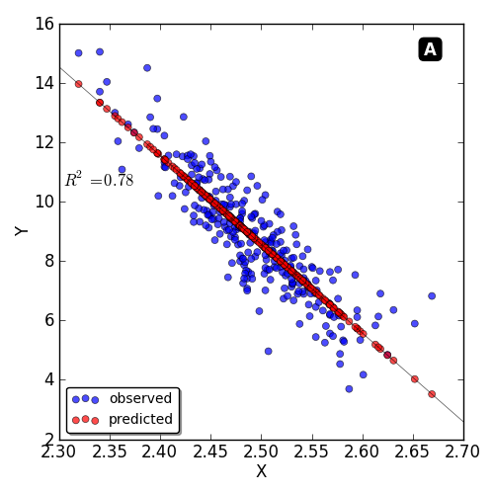
root-mean-square deviation ( root-mean-square error)
= 0.7// 0 - 1
x1
x2
X1 - X2

Slide 17
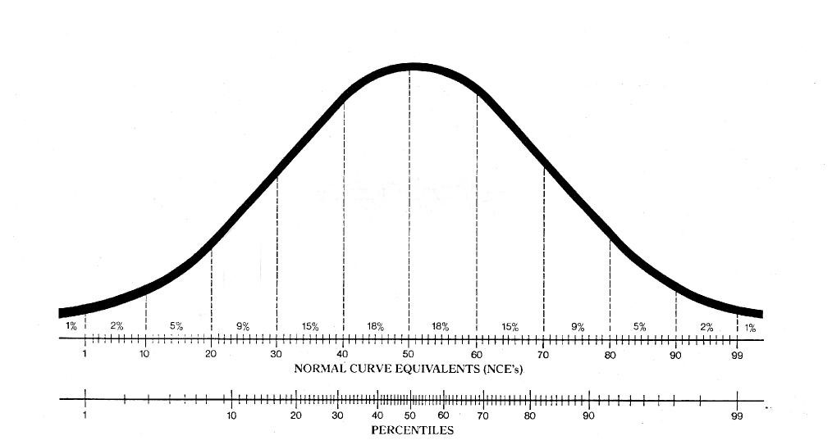
0.8
0.2
http://www.iephelp.com/2015/02/lions-tigers-test-scores-oh/

Slide 18
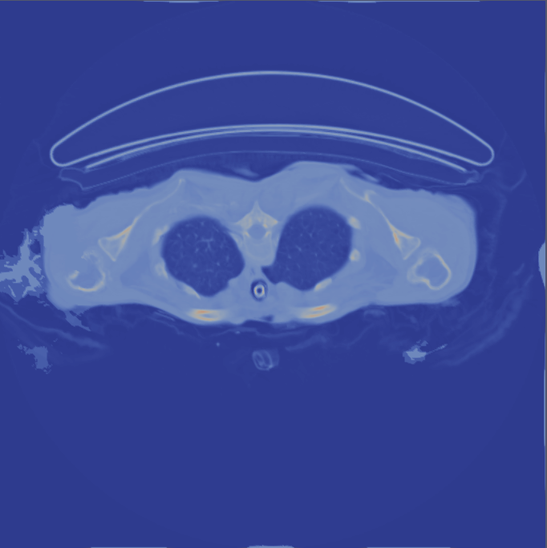
Before root-mean-square deviation
After root-mean-square deviation

Slide 19
Work cited
http://www.jacmp.org/index.php/jacmp/article/view/3834/2789
http://www.writedesignonline.com/resources/design/rules/color.html

Slide 20
2D Thirion’s Demons
Input
2D DICOM images
Taken from same patient at two different time
Apply discrete Gaussian smooth filter (ITK::DiscreteGaussianImageFilter)
Apply 2D Thirion’s Demons Algorithm (ITK::DeformableRegistration2)
Different parameters were tested
number of iterations
standard deviations
Make checkboard from 2D image to compare moving images before and after registration (VTK::CheckBoardWidget)

Slide 21
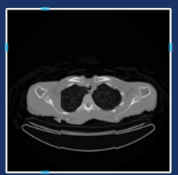
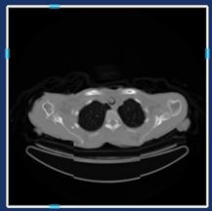
2D Thirion’s Demons, results
Before registration
After registration (100 iteration, 1 std)

Slide 22
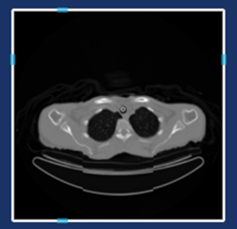
2D Thirion’s Demons, results
Before registration
After registration (100 iteration, 10 std)

Slide 23
2D Thirion’s Demons, results
Advantage:
Low time complexity of 2D analysis
Easy visualization of 2D result
Disadvantage:
Not use all the available information (spatial information)
Difficult to choose the right slices to perform image registration

Slide 24
What is Segmentation?
-A process to partitioning an image into multiple segments
-Change/simplify the image into something more meaningful and easier to analyze
-Assigns labels to all the pixels of an image so that pixels with similar labels would share similar characteristics

Slide 25
Watershed Segmentation
-Grayscale
-A drop of water following the gradient of an image flows along the path to reach a local minimum

Slide 26
Watershed Segmentation ITK
-WatershedSegmentation2 ITK from examples
-Takes input 3D medical image and outputs segmented 3D medical image

Slide 27
Watershed Segmentation Input
-Format (from command line)
-InputImage
-outputImage: output file name and location
-lowerTreshold: We tested threshold levels of between 0.01 to 0.05
-outputScaleLevel: We tested levels of between 0.1 to 0.5

Slide 28
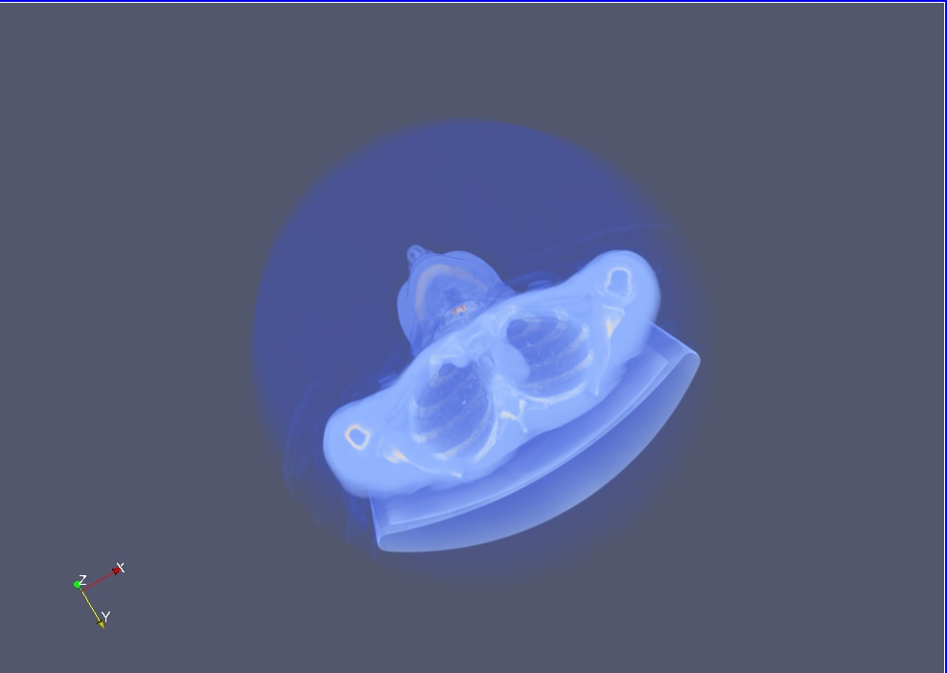
Watershed Segmentation Input
-Example input used to test

Slide 29
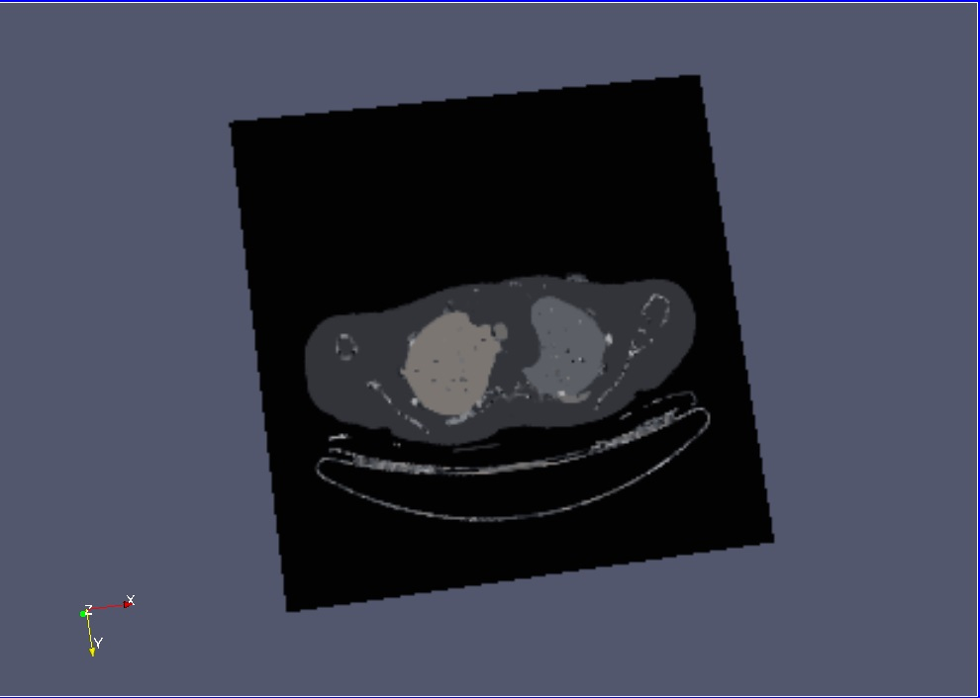
Watershed Segmentation Output
-Example output

Slide 30
Early testing stages
-Was hard to test segmentation prior to learning techniques from class
-Took hours (up to 7) to compile code and get an output
-A lot of trial and error to get better results

Slide 31
Direct image processing for quantification
Sometimes, it is better to write code to directly process the .vtk file.

Slide 32
Direct image processing for quantification
Pros
Implement new functionality if VTK doesn’t provide it.
Reimplement functionality but with significant performance improvements.
You can implement a stand-alone program without having to include and build within the vtk framework (cmake , vtk , etc)
Cons
Puts burden on the programmer to process the file
Loses some integration with the VTK framework.

Slide 33
.vtk file format
The vtk file format begins with header information, then a bunch of 3-bytes information that represent intensity value of each voxel.

Slide 34
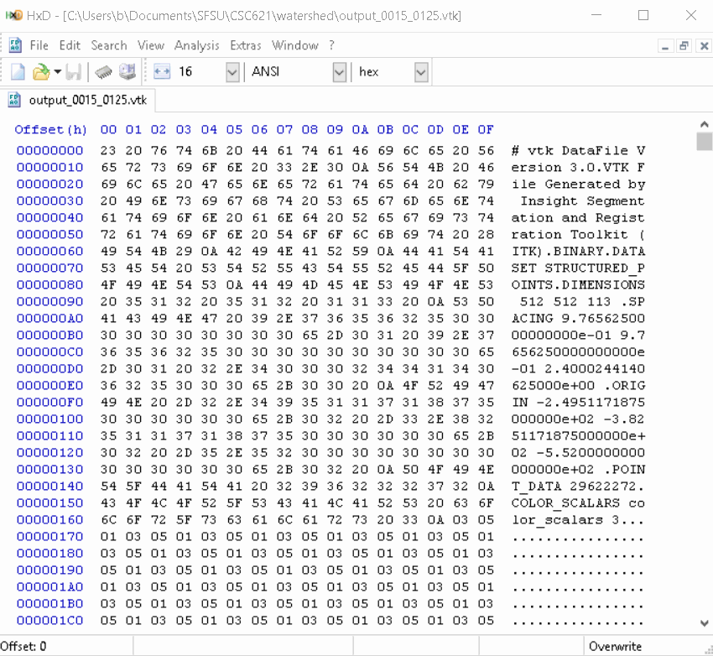
.vtk file format
The header contains various metadata, delimited by 9 characters ‘\n’
It contains information such as the dimensions of the file (In this example 512 * 512 * 113).
The dimension tells you how many total voxels are present in the file (29,622,272 voxels).

Slide 35
.vtk file format (binary file)
It takes 3 bytes to represent the intensity information of a voxel.
The spatial information of a voxel is simply the location of the 3 bytes in the file
29,622,272 voxels * 3 bytes per voxel = 88,866,816 bytes
In our example , it takes 88,866,816 bytes to represent the intensity values of all voxels.

Slide 36
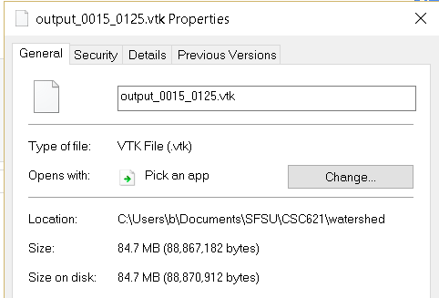
.vtk file format (binary file)
88,866,816 bytes to represent all voxels
The file itself is 88,867,182 bytes.
There is a difference of 366 bytes
The 366 bytes is actually the header in our example. Other .vtk files might have different amount of bytes for the header.

Slide 37
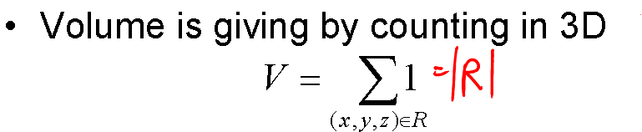
Quantification technique
Based on counting the number of voxels that corresponds to a particular intensity value.
Assumes that voxels with the same intensity values are part of the same region.
Also assumes that voxels with different intensity values are not part of the same region.

Slide 38
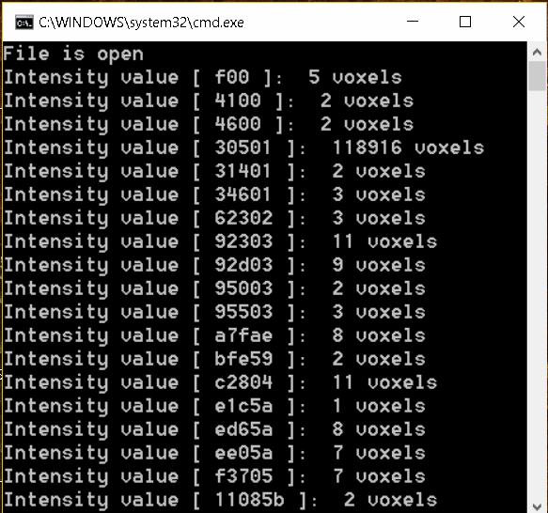
Actual processing
Notice that the intensity value 03 05 01 is very high
The value 03 05 01 represents empty space.
Also notice many values with less than 20 voxels.
Due to watershed technique, it tends to over segment the image.

Slide 39
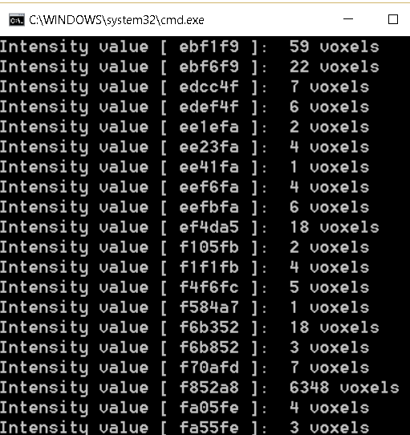
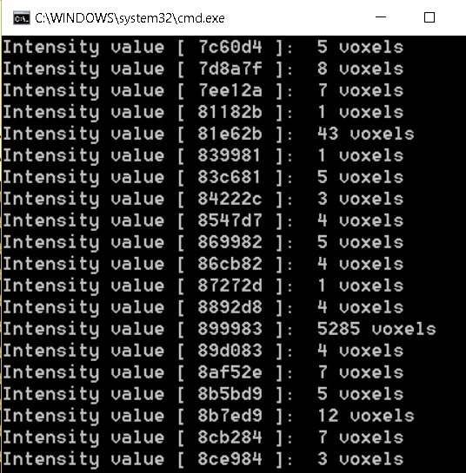

Slide 40
Some problems with processing vtk files
Couldn’t figure out how to get the volume of each voxels

Slide 41
Some tips with processing vtk files.
Use the map data-structure (also known as dictionary or associative array).
#include <map>
map<int,int> voxel_intensity_values;
Use iterators to iterate through elements in the map data structure.
std::map<int, int>::iterator it = voxel_intensity_values.begin()
for (std::map<int, int>::iterator it = voxel_intensity_values.begin(); it != voxel_intensity_values.end(); ++it)

Slide 42
Visualization
Render the results of Registration and Segmentation
Using vtk:SmartVolumeMapper
DicomSeriesReadImageWrite2 takes a series of dicom images and makes a 3d volume.
SmartVolumeMapper takes a vtk file
Then renders it.
Color and Opacity mapped using CT Number(Hounsfield Unit) of Skin, Bone

Slide 43
Visualization
vtkInteractorStyleImage’s Image 3D mode for Imaging Slicing
Unfortunately controls are awkward, i.e. need to be in coronal view to slice sagittal view.
Changes revert with manual camera adjustment.
Solution, use vtkImplicitPlaneWidget
Bound a plane to the bounds of the volume.
Add the plane to the volume mapper as a clipping plane.
Rotate and Shift the plane to Slice through the image.
Distance Estimation using vtkDistanceWidget
Measures the distance between two points
Videos: Distance - https://youtu.be/PuQHD7UCu_g , Slice - https://youtu.be/6B3NpzAabAQ

Slide 44
Thank You!
Questions?

